Slide 1
CluedIn AI training: Copilot
Streamlining manual effort with smart automation —your AI-powered partner for everyday data tasks

Slide 2
Training agenda
Discover what CluedIn Copilot is and how it helps automate everyday data management tasks
Learn how to interact with CluedIn Copilot
Explore examples of Copilot skills

Slide 3






Agentic Data Management with
Hi, how can I help you?
AI Agents and Copilot
Mapping, fixing, and governing data is now
as simple as asking — 24/7, in real time

Slide 4




CluedIn Copilot
Copilot
Hi, how can I help you?
Create a golden record rule that applies to all golden records from the /Client business domain.
The rule should tag records and include 3 actions.
Name the rule “Client data validation”.
Action 1. If client.email does not match common email RegExp, tag the record with “invalid-validation-email”.
Action 2. If client.phone contains anything other than numbers, tag the record with “invalid-validation-phone”.
Action 3. If client.leadStatus is new and the credit limit is …
CluedIn Copilot is your always-available, AI-powered assistant for data management.
It allows you to perform a wide range of tasks across CluedIn—simply by typing what you need, in plain, natural language.
4

Slide 5
50+ Copilot skills at your fingertips
From data analysis to rule creation and deduplication—Copilot helps you manage it all with simple, natural language
Activate rule
Clone rule
Create stream
Clone stream
Deactivate rule
Create rule
Start stream
List stream
Reprocess rule
Get data quality metrics
Create glossary term
List glossary categories
Detect anomaly in vocabulary key
Create deduplication matching rules
Create vocabulary
List vocabularies
Create deduplication project
Create vocabulary key
List vocabulary key
Profile vocabulary key
Suggest rules for vocabulary key
Standardize vocabulary key data
Explain deduplication group
Change vocabulary key to glossary term lookup
And many more…

Slide 6
Skill chaining
Copilot
Hi, how can I help you?
Create a rule that tags all records with customer.country set to 'Norway' as 'Nordic’.
Then, activate and reprocess the rule.
To enhance your efficiency in interacting with CluedIn Copilot, you can chain different skills together.
Instead of creating separate prompts for actions like creating, activating, and reprocessing a rule, you can combine these tasks in a single prompt.
6

Slide 7
Access to general knowledge
Copilot
Hi, how can I help you?
Can you create a golden record rule that tags Company records where the company.state is not one of the Australian states.
Backed by the underlying large language model (LLM), Copilot understands the meaning and context behind your data, and can work with it intelligently, even without explicit reference data.
7

Slide 8
Multi-language support
Copilot
Hi, how can I help you?
Créez une règle qui marque tous les enregistrements dont customer.country est défini sur "Norway" comme "Nordic".
Ensuite, activez et retraiterez la règle.
CluedIn Copilot supports multiple languages, allowing you to interact with the platform in the language you’re most comfortable with.
No configuration or translation is needed—just type your request, and Copilot will understand and execute it.
8

Slide 9
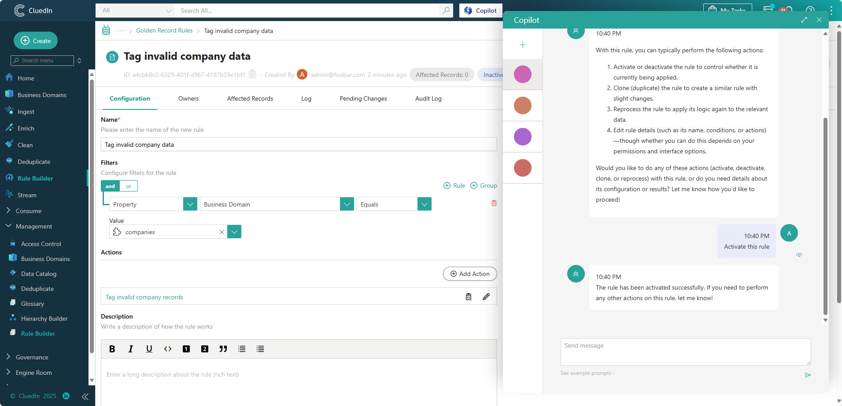

Locational awareness
CluedIn Copilot understands your current location within the platform—whether you’re viewing a dataset, a vocabulary key, or a golden record.

Slide 10

Direct execution
Copilot performs actions immediately, streamlining your workflow but requiring careful input.

Slide 11
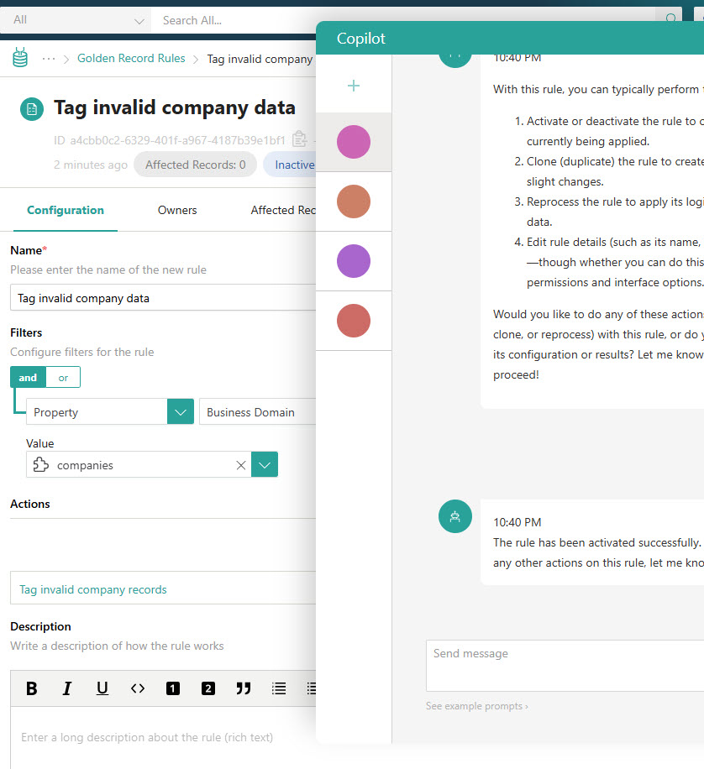


Learn more about CluedIn Copilot in our documentation portal.
Next session: Using CluedIn Copilot in practice.
What’s next?

